Slide 1
Appointemnts System
Mohammad Shalabi

Slide 2
Appointments

Slide 3
Customer Requests
Queues
Appointment Controller
Monday Processes
Tuesday Processor
Appointment Service
Sunday Processor
Data layer

Slide 4
Reporting

Slide 5
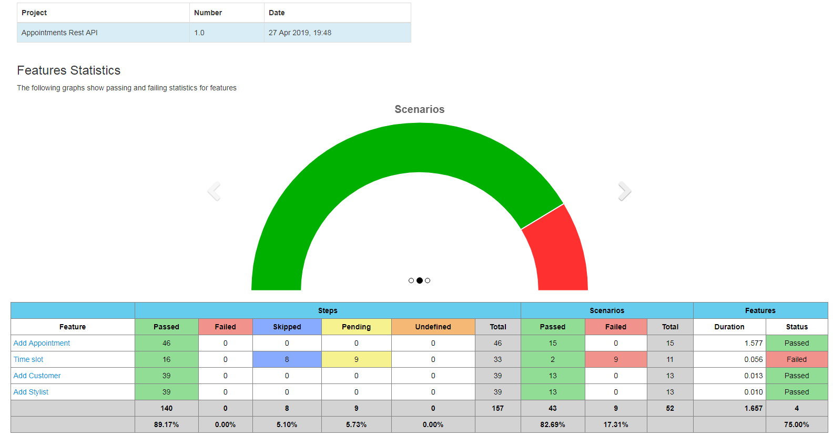

Slide 6
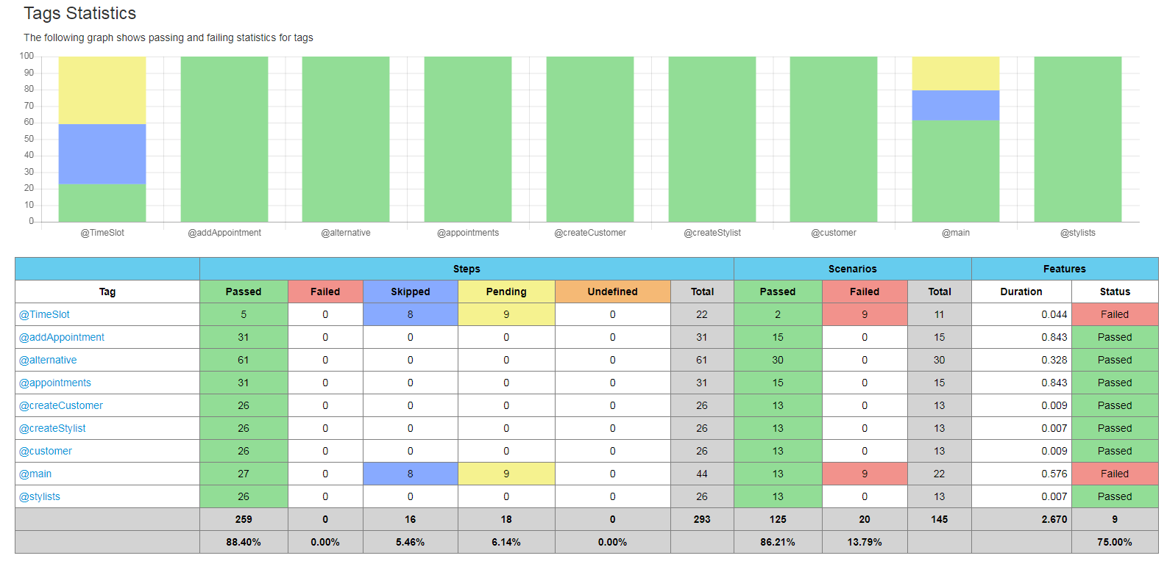

Slide 7
Testing Diagrams

Slide 8
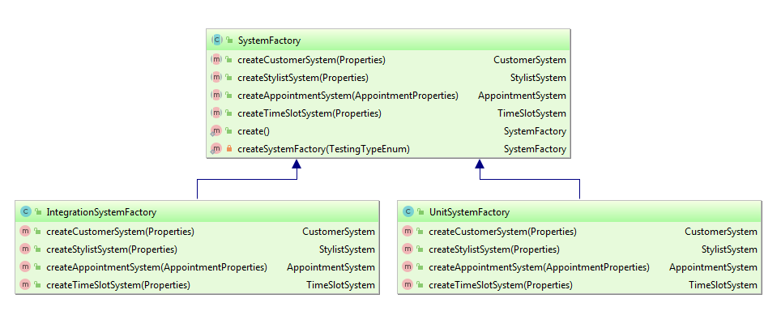
Abstract Factory

Slide 9
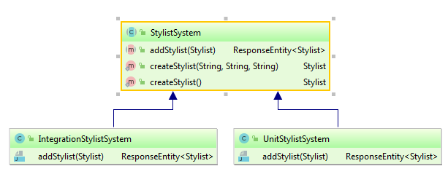
Stylist System

Slide 10
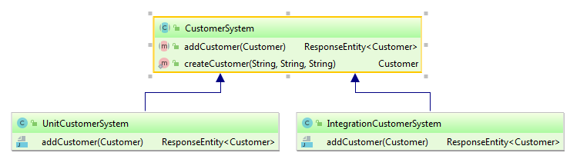
Customer System

Slide 11
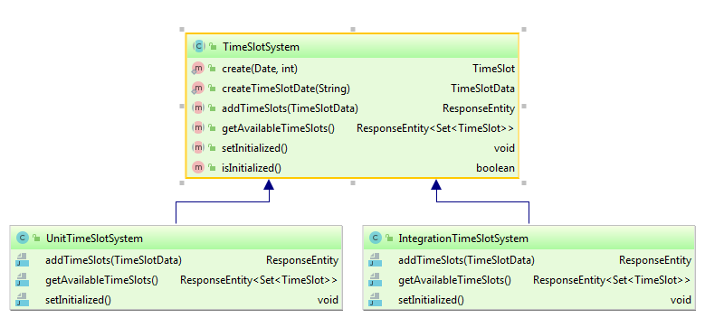
Time Slot system

